Slide 1
A meta-analysis of integrated multi-trophic aquaculture: Extractive species growth responses & future information needs. Daniel Kerrigan & Coleen Suckling coleen.suckling@bangor.ac.uk coleen.suckling@cantab.net Twitter: colckl
Notes:
Daniel was a student of mine – now based in New Zealand working for the Env. Agency. Very kindly allowed me to present this research to you today.

Slide 2
Integrated multi-trophic aquaculture (IMTA)
Extractive species:
Fed aquaculture (finfish)
Organic
(shellfish)
Inorganic
(seaweed)
Chopin, 2006
Notes:
Fish farming negative environmental impacts due to the release of waste which can in turn deteriorate the localized benthos. Integrating other commercially important species which can intercept this waste can potentially reduce this.
Fish release nutrients in particulate organic form (faeces & leftover pellets) and dissolved inorganic form- nutrient leaching from POM and
IMTA – more than one commercil spcies farmed together which can recycle the waste reducing enviorment al impact, msximising profit.
In Europe it is not widely adopted for sveral reasons, one of which is due to insufficient information which farmers find useful when considering these apporaches. So I decided I wanted to…..

Slide 3
IMTA – knowledge needs
Extractive species:
Fed aquaculture (finfish)
General growth patterns?
Spatial scale?
Schematic adapted from Chopin, 2006; Kerrigan & Suckling, 2016

Slide 4
Meta-analysis
Systematic data mining.
Growth responses:
Effect size – standardized mean difference in standard deviation units.
Weight effects – accounts for variance between & within studies (Random effects model)
http://marineculture.com.au/index.php?id=sizing-chart
Kerrigan & Suckling, 2016. Reviews in Aquaculture
Notes:
Use standardised mean differences as a measure of effect size – extract and use reported means & SD units.
Bivlaves –lnnegth
Alagae – blade engths, biomass production & relative gorwth rates
Correct the data according to sample numbers used (bias upwards small nos) – Hedge’s g
Weight the data apply a random effects model – basically what this does is accounts for two sources of sampling error - Variance within a study and between studies.

Slide 5
IMTA – bivalve growth
 | Crassostrea gigas Ostrea edulis
 | Mytilus edulis M. galloprovincialis M. planulatus
 | Plactopecten magellanicus
Kerrigan & Suckling, 2016. Reviews in Aquaculture

Slide 6
IMTA – macroalgal growth
 | Gracilaria chilensis Palmaria palmata
 | Saccharina latissima Sargassum hemiphyllum S. henslowianum
 | Ulva sp.
Kerrigan & Suckling, 2016. Reviews in Aquaculture

Slide 7
IMTA – bivalve growth
Overall positive growth response
± 95% CI
Kerrigan & Suckling, 2016. Reviews in Aquaculture
Notes:
Effect size – difference between control & the expt group – in this case = mussels grown within the vicinity of a fish farm nutrient source.– mean difference – therefore if your weighted mean effect size and it’s confidence interval does not cross zero, indicates a sig
Illustrates quite nicely that there are variable repsonses across the studies so making generla comparison studies are difficult, hnce why these apporaches are vyer useful to carry out.
Total effect size all studies

Slide 8
IMTA – macroalgal growth
Overall positive growth response
± 95% CI
Kerrigan & Suckling, 2016. Reviews in Aquaculture
Notes:
These data are extremely variable, and just about touch onto the non-sig side when you lokk at each study. But again the REM takes ito accoutn the between study ariation (e.g. different apporaches etc) and reveals that there is an overall positive growth reponse.

Slide 9
IMTA – spatial scale for extractive growth
± 95% CI
± 95% CI
Kerrigan & Suckling, 2016. Reviews in Aquaculture

Slide 10
IMTA – new knowledge
Extractive species:
Fed aquaculture (finfish)
Positive product growth
close
60 m
Relatively close proximity
Schematic adapted from Chopin, 2006; Kerrigan & Suckling, 2016
Notes:
New knowledge. But I want to be very transparent about this study – the approaches taken here relatively crude (physically calculated - great tools which we now use in R metaphor with much greater power to test the robustness of these types of studies which we’ll be using in the future). Approaches are limited – species which will different natural rates of growth have ben clumped together purely down to limited data availability. It’s also perhaps a bit too early to be making any solid conclusions on these particular quesitons we’ve been addressing but this has been done on purpose which I’ll outline why now.

Slide 11
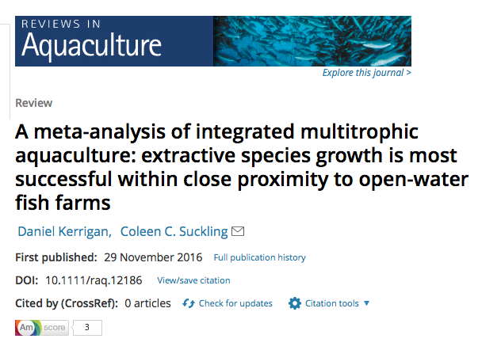
Meta-analysis
Reveals issues in the field:
Selection of control sites
Publication bias
More site information – multi-disciplinary
Great tool!
Move field forward.

Slide 12
Thank you
Daniel Kerrigan
coleen.suckling@bangor.ac.uk coleen.suckling@cantab.net Twitter: colckl
Notes:
Will happily forward you Dan’s email address if you wish to contact him directly.

